Slide 1
SCALING UP RENEWABLE ENERGY INVESTMENTS
New Energy Events Webinar
1 February 2016
Aleksi Lumijarvi
Programme Officer, Renewable Energy Private Sector Finance, IRENA

Slide 2
Online portal
http://www.irena.org/marketplace

Slide 3
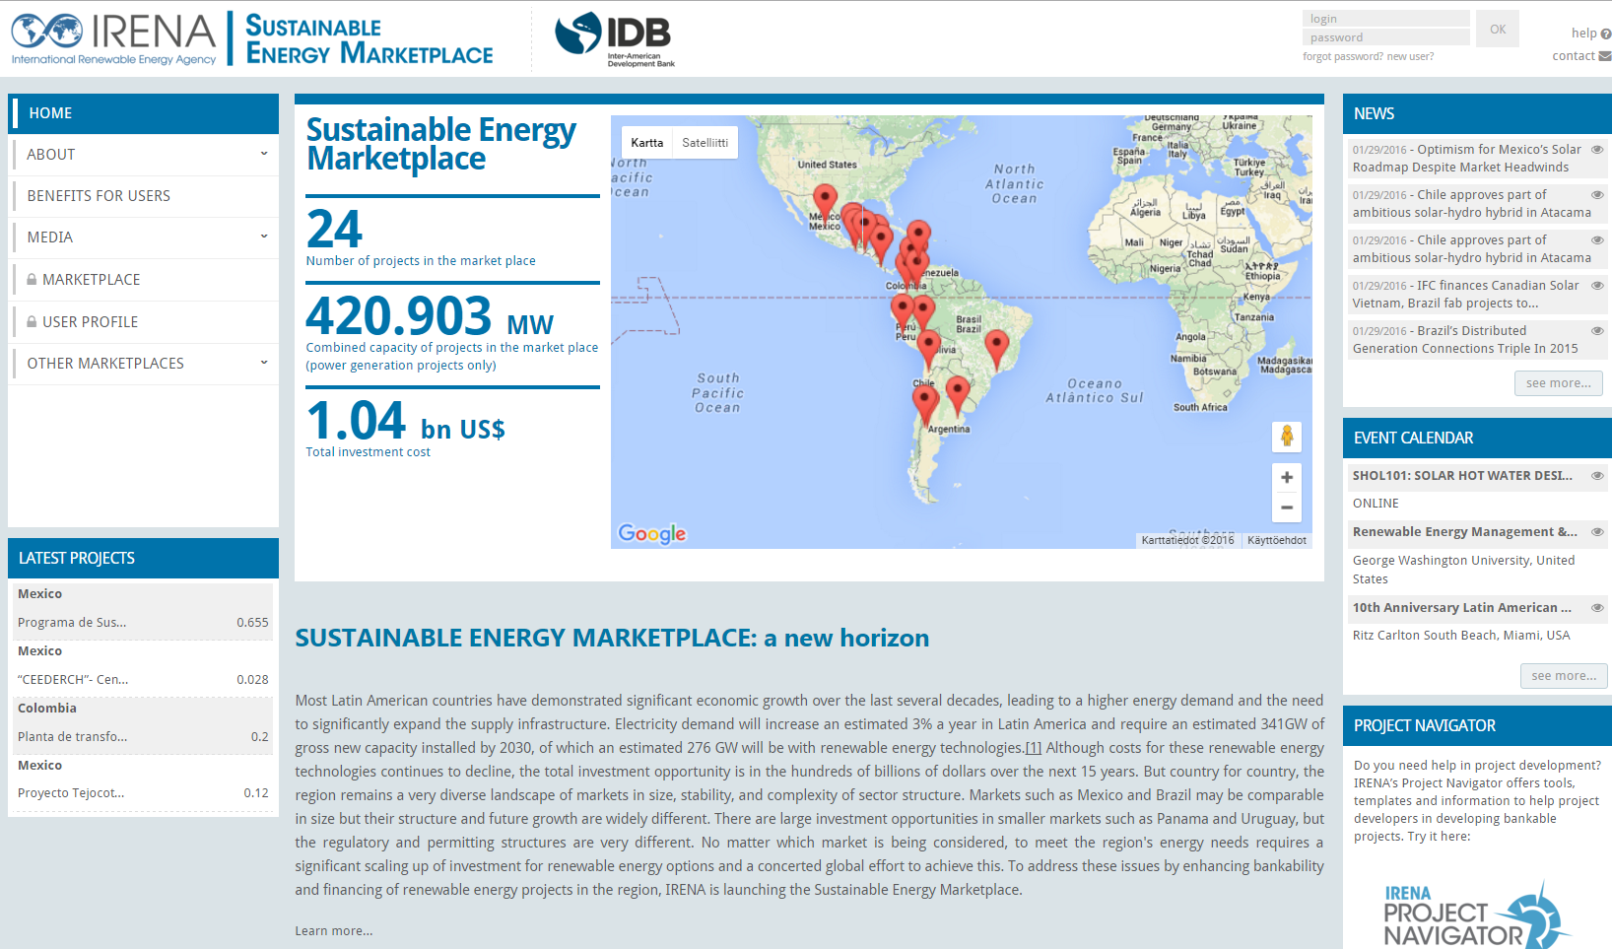
Matchmaking / search engine

Slide 4
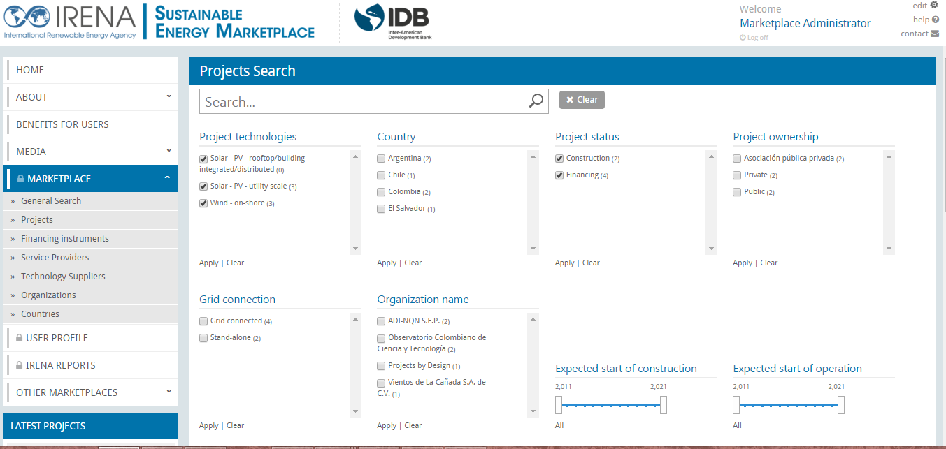
Matchmaking / search engine

Slide 5
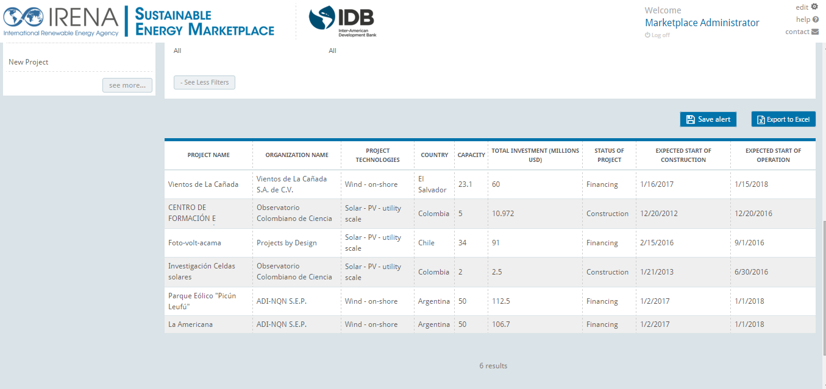
Matchmaking / search engine

Slide 6
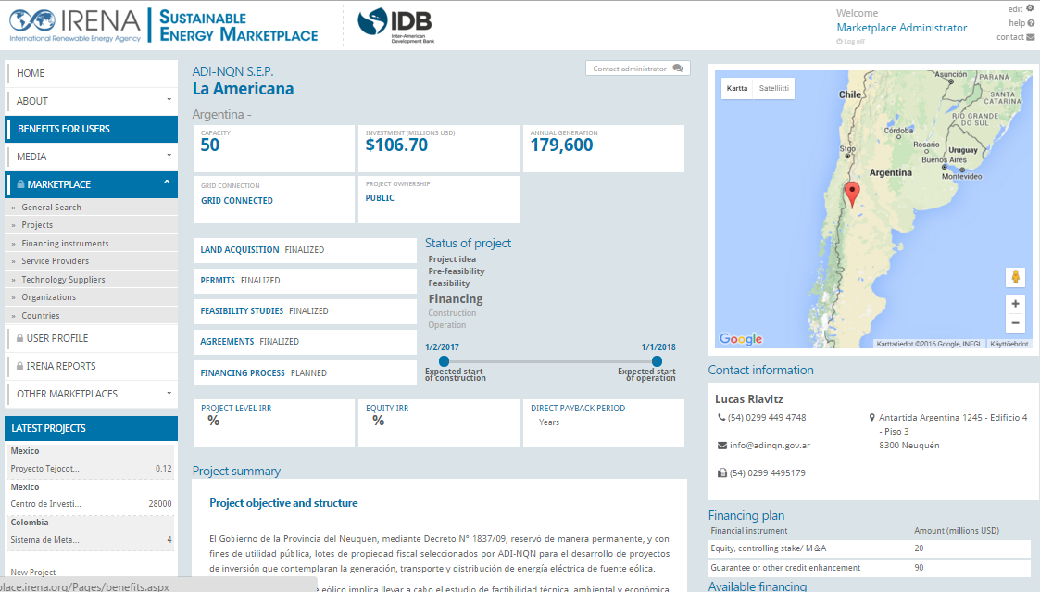
Matchmaking / search engine

Slide 7
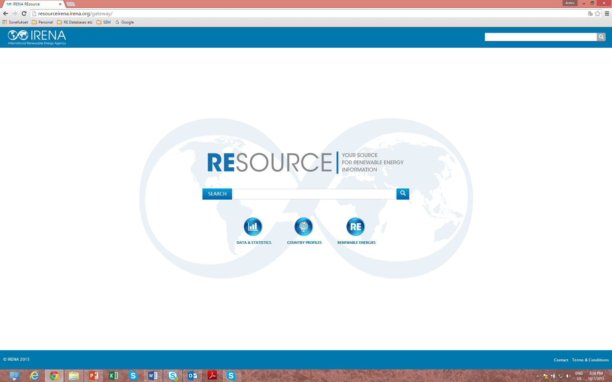
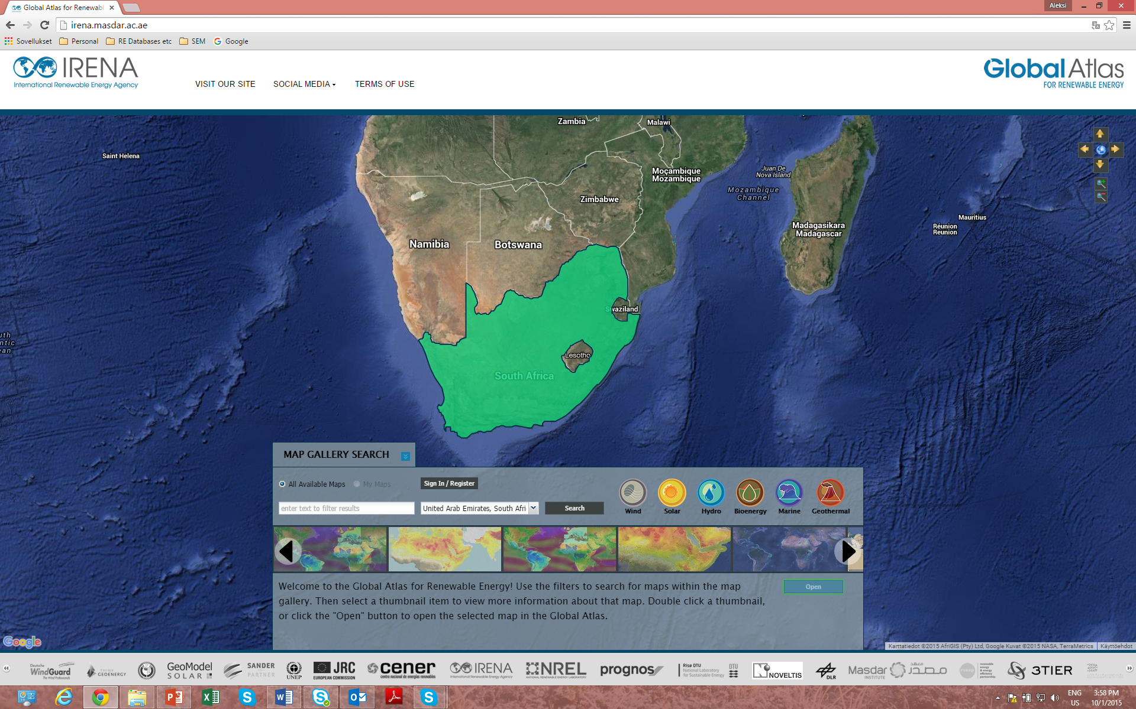
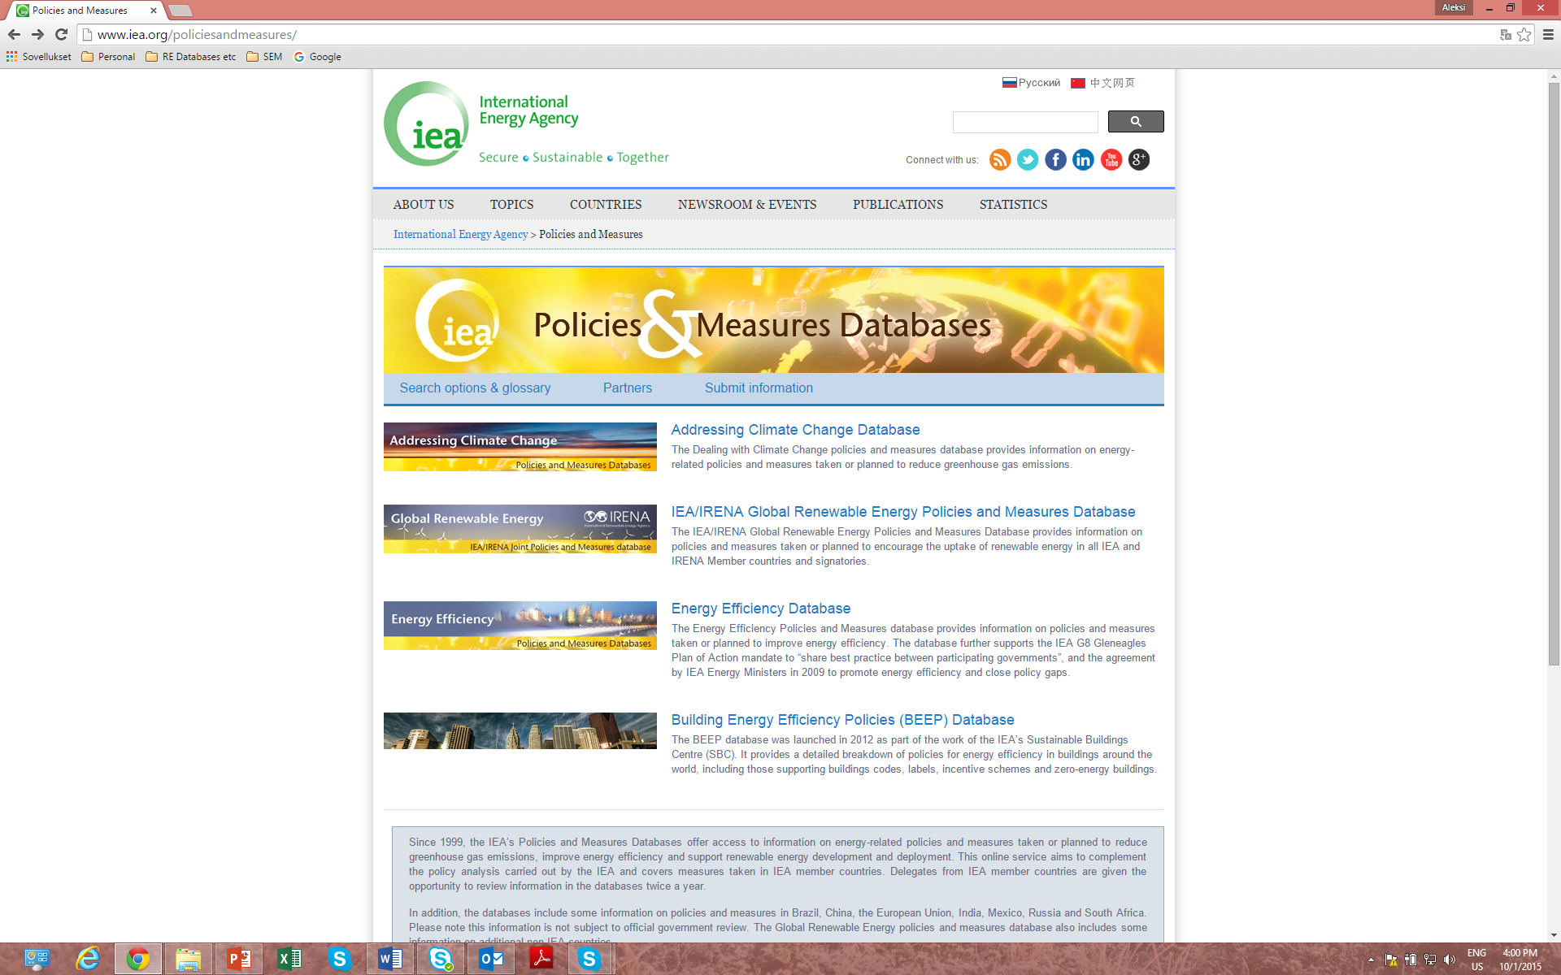
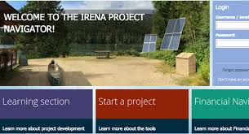
Tools and databases

Slide 8
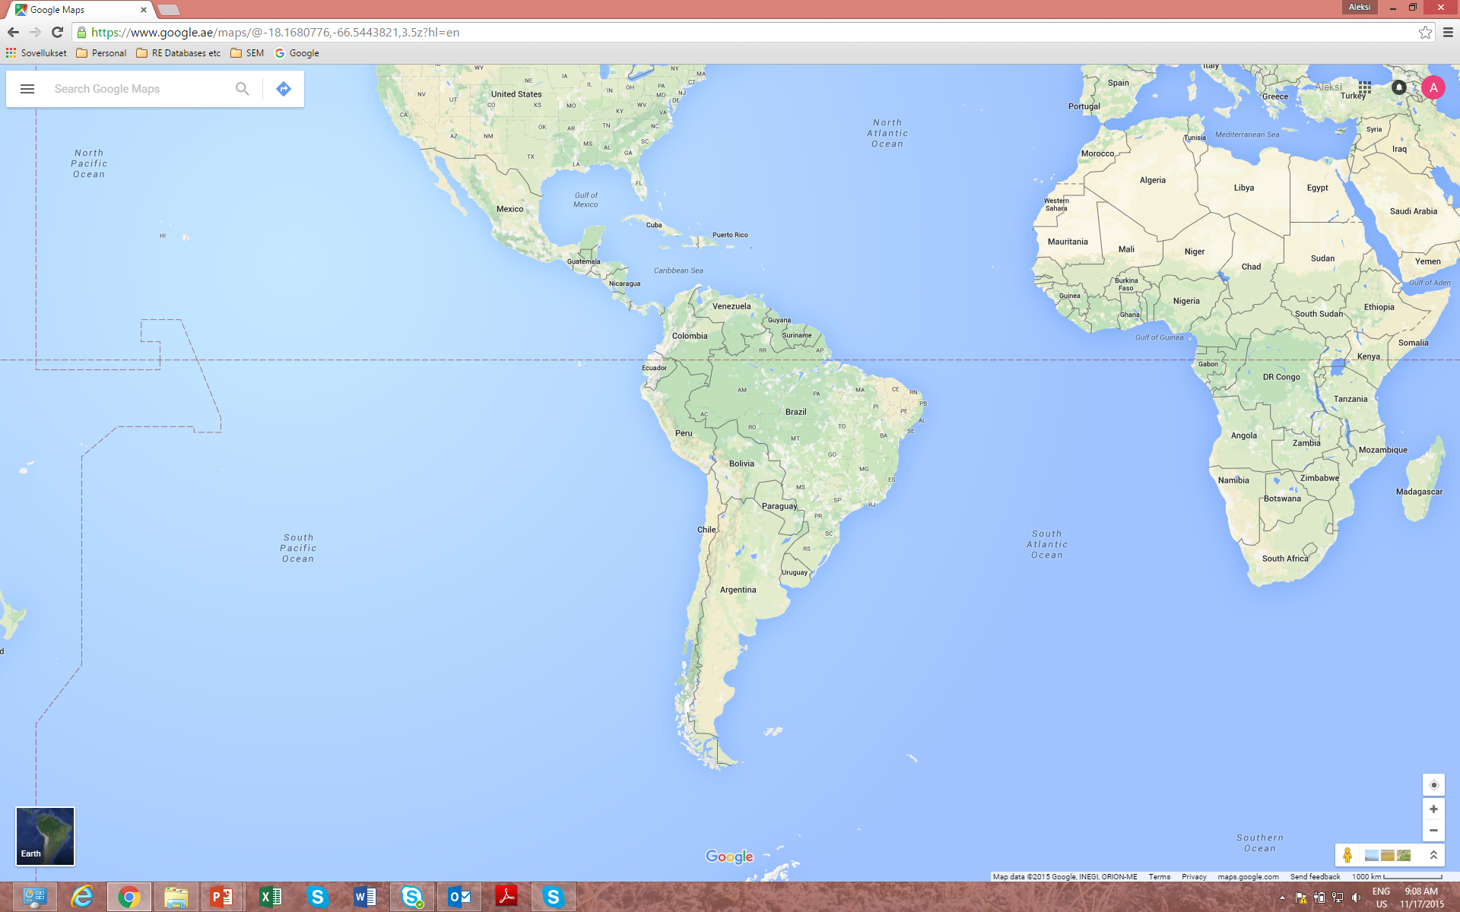
Engaging partners in project facilitation
Objective: Project origination, development and match-making
Notes:
Close cooperation with countries to promote their project pipelines and investment environments
Cooperation with prominent IFIs and donor facilities to provide hands-on support for projects
Not doing what others are already doing; instead leveraging existing resources and activities by prominent actors
Advanced stage of negotiations for cooperation agreements with several such institutions, some of which will be announced at COP21.
Inter-American Development Bank (IDB)
Power Africa
CTI PFAN -- Private Financial Advisory Network
EEP -- Energy and Environment Partnership with Southern and East Africa (donors: UK, Finland and Austria)
Already doing joint outreach with IDB and EEP.

Slide 9
Thank you!
http://www.irena.org/marketplace

