Slide 1
75MWp Solar PV Plant in El Salvador
July 2015

Slide 2
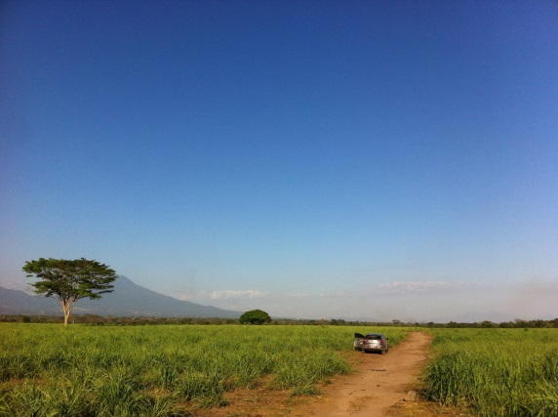
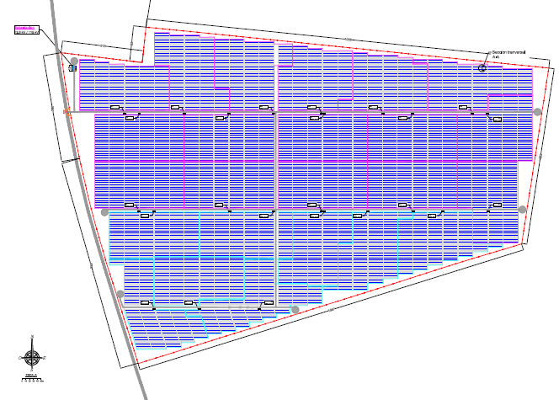
One of the Largest Solar PV Project in Central America
Key Figures
60MWac / 75MWp
Attractive price of $101.90/MWh
c. US$130m Investment
A 250Mz totally flat site
An industrial and highly secured area
3% of Revenues invested in Social Development
Development Status
90% of the permits obtained
Final negotiations with EPCs
Financial due diligence in process
Anticipated COD: Q4 2016

Slide 3
Key Success Factors (1/3): Neoen, an Majority Shareholder with a Long Term Vision
A renewable integrated IPP
Strong Focus on solar and wind
A Developer / Investor with long term vision
Develop, invest and Stay
Reasonable expectations
Local presence
458MW fully financed in construction/operation – 1GW targeted by 2017
300MW in construction in Cestas, France
Strong and ambitious shareholders

Slide 4
Key Success Factors (2/3): The Good Mix of Sponsors
Gustavo E. Siman
International Experience
Strong Shareholders
Shareholders
Complementary Team
A Long Term Vision

Slide 5
Key Success Factors (3/3): Why it Does Work in El Salvador
An open and well organized tender process
Timely managed
Good level of bid and pre-operating bonds
Strong regulation body
Good involvement of SIGET / CNE which ensured a transparent and well executed process
Strong offtakers and distribution companies
Attractive off-taking mix with companies with good credit rating

Slide 6
But Risks are Still Here…
A First-of-a-Kind for El Salvador
Interconnection
Change of Law
Security

Slide 7
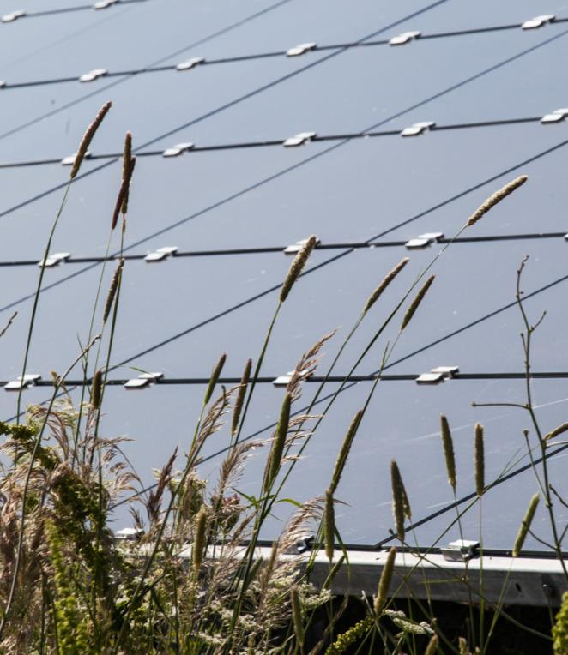
Thank you for your attention
Emmanuel PUJOL
General Manager Central America
emmanuel.pujol@neoen.com
+ 503 7851 7139
PARIS (HQ) | LISBON | SYDNEY | MEXICO | CAIRO | SAN SALVADOR
www.neoen.com
Notes:
Je suis à votre disposition.

